Slide 1
Scientific Text Mining and Knowledge Graphs Chapter 1 Part 1: Phrase Mining
Presenter: Jingbo Shang
University of California, San Diego
jshang@ucsd.edu
Notes:
Thank you for the introduction!
Good morning, everyone!
This is Jingbo Shang from UIUC. I’m very excited to share my research with you!
My talk today is mainly about AutoNet. Automated Network Construction from Massive Text Corpora.

Slide 2
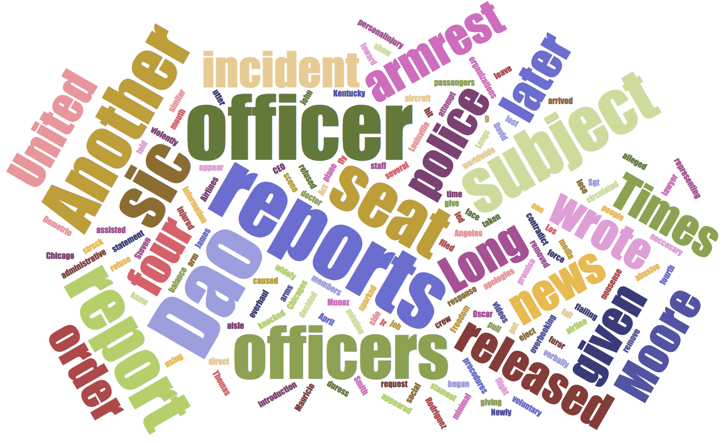

Why Phrase Mining?
Analyzes US news articles on April 9, 2017
Before Phrase Mining
Which “United”?
United States?
United Parcel Service?
What’s “Dao”?
A person?
A place?
Notes:
Suppose we are analyzing all US news articles on April 9, 2017.
Without phrase mining, we can only count the frequency of single words.
And then, we plot a word cloud.
There are many interesting keywords here, such as “United” and “Dao”.
You may wonder now, what are their meanings?
Is this “United” “United States”?
Is this “Dao” a person or a place?
We don’t know.

Slide 3
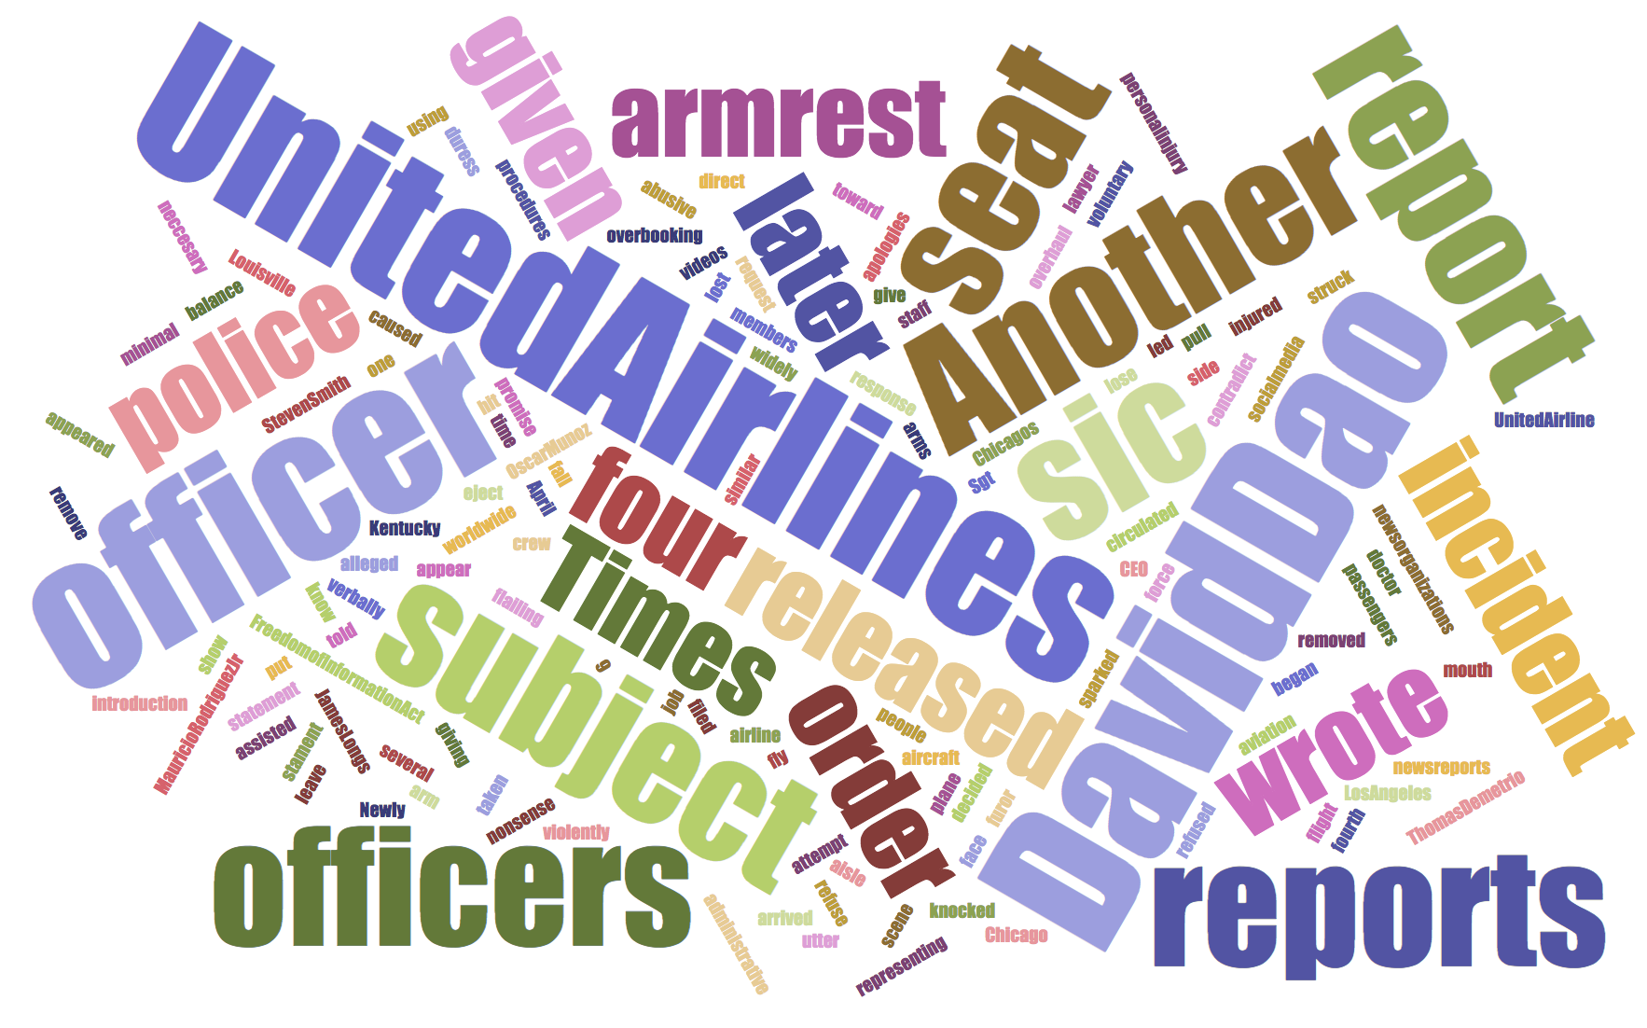

Why Phrase Mining?
Analyzes US news articles on April 9, 2017
After Phrase Mining
United Airline
David Dao → A person
United Express Flight 3411 incident
Notes:
What if we have phrase mining?
Instead of single words, we can now count frequency of phrases and plot a phrase cloud.
It is now clear that ”United” is ”United Airline” and “Dao” is “David Dao”, which is a person.
And you can immediately understand that these phrases are talking about the well-known United Airline incident – the security guards pouched a passenger David Dao at the ORD airport in Chicago.

Slide 4
Phrase Mining: A Keystone
Phrase mining is a keystone towards understanding texts
Entities, Relational Phrases, …
It can facilitate various applications in Natural Language Processing (NLP), Information Retrieval (IR), Text Mining
Document Analysis
Indexing in Search Engine
Key-Phrases for Topic Modeling
Summarization
Text-based Predictive Analytics
…
Notes:
From this example, we can see that phrase mining is a keystone towards text understanding.
It can benefit a lot of downstream applications in NLP, IR, and Text Mining.
We have seen an example of document analysis.
Phrases can be used in search engine to better understand your query.
And more importantly, using phrases, one can easily upgrade all text analysis models from the word level to the phrase level.

Slide 5
Quality Phrase Mining from Massive Domain-Specific Corpora
Quality phrase mining seeks to extract a ranked list of phrases with decreasing quality from a large collection of documents
Examples:
Existing NLP-based methods (e.g., noun phrase chunking, parsing) rely on extensive annotations from domain experts
Expected Results
… data mining machine learning information retrieval … support vector machine …
Expected Results
… US President Anderson Cooper Barack Obama … Obama administration …
Scientific Papers
News
Articles
Notes:
Let’s formally define the quality phrase mining problem.
We are going to extract a ranked list of phrases from a domain-specific corpus.
When the input contains computer science papers, we expect to see these terminologies.
When the input contains news articles, we expect to see the names of person, location, and organization.
There are some NLP-based methods, such as noun phrase chunking and parsing, can also extract phrases.
But these methods require extensive annotations to train the models. We will compare with them later.

Slide 6
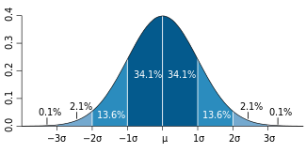
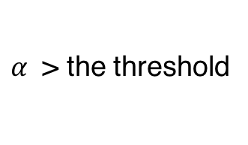
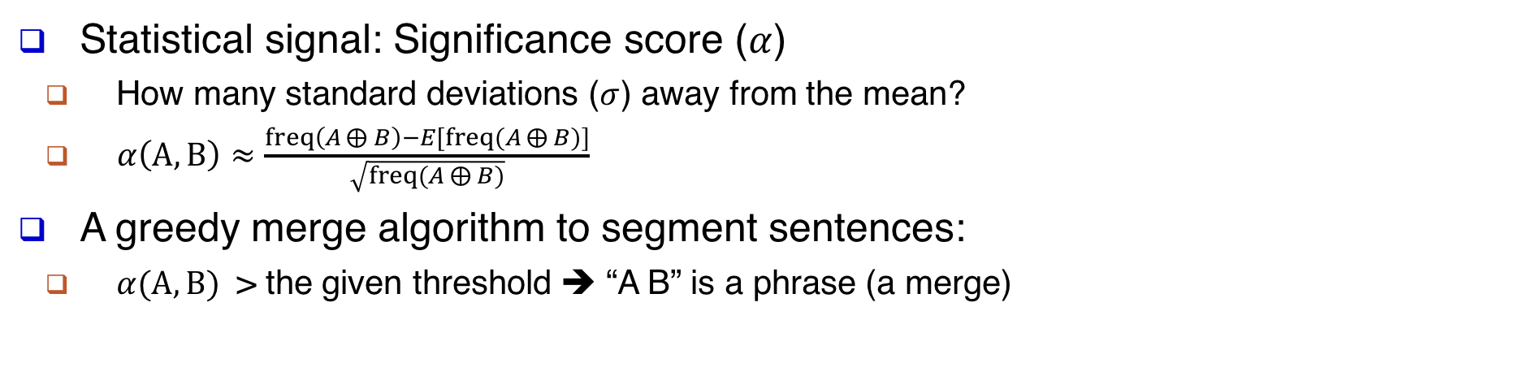
TopMine (VLDB’15): Our Unsupervised Pioneer on “Segmentation”
Statistical signal: Significance score ($α$)
How many standard deviations ($σ$) away from the mean?
$α\left(A, B\right)≈\frac{freq\left(A⨁{B}\right)−E[freq(A⨁{B})]}{\sqrt{freq(A⨁{B})}}$
A greedy merge algorithm to segment sentences:
$α(A, B)$ > the given threshold ➔ “A B” is a phrase (a merge)
Segmentation:
Markov Blanket
Feature Selection
for
Support Vector Machine
$α$ > the threshold
Support Vector
Raw Input:
Markov
Blanket
Feature
Selection
for
Support
Vector
Machine
Notes:
As we focus on reducing expert effort, we first introduce an unsupervised method, TopMine.
TopMine mainly leverages the significance score, alpha.
As you may know, alpha measures how many standard deviation away from the mean.
TopMine uses a greedy merge algorithm to segment sentences.
For example, here, we have a title from a computer science paper, “Markov Blanket …”.
We will look at every two adjacent tokens in this sentence and compute their alpha scores. If alpha is more than a given threshold, we will merge them as a potential phrase. We repeat this process until there is no such pair.
So in the end, we will know “Markov Blanket”, “Feature Selection”, and “Support Vector Machine” are 3 multi-word phrases from this sentence.
However, there are other statistical signals might be useful, such as point-wise mutual information and chi-square.
It is difficult to unify multiple statistical signals in an unsupervised framework.

Slide 7
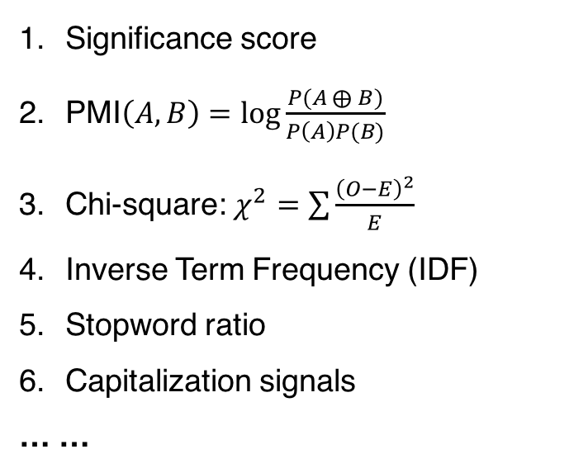
SegPhrase (SIGMOD’15): Quality Estimation using Expert Labels
Estimated Quality Score for Every Phrase
Multiple Statistical Signals
Significance score
PMI$\left(A, B\right)=\log{\frac{P(A⨁{B})}{P\left(A\right)P(B)}}$
Chi-square: $χ^{2}=\sum{\frac{{\left(O−E\right)}^{2}}{E}}$
Inverse Term Frequency (IDF)
Stopword ratio
Capitalization signals
… …
0.999, support vector machine
0.999, objective function
0.999, source code
0.999, upper bound
0.999, optical flow
0.999, hidden markov model
…
0.851, period doubling
0.851, digital game based learning
0.850, bus architecture
0.850, parabolic partial differential equations
…
0.000, this paper
...
0 this paper
0 experiments show
……
1 support vector machine
1 np hard
……
Input
Raw Corpus
Quality Estimation based on
Expert-Provided Labels
Notes:
Therefore, we propose SegPhrase.
It combines multiple statistical signals using a classifier based on expert-provided labels.
This classifier will give a score between 0 and 1 to each phrase.
1 means it is a high-quality phrase and 0 means it is a low-quality phrase.
The given labels are binary.
For example, if the input is about CS papers, we will say “this paper” is a low-quality phrase, as it is a stopword-like phrase;
We will say “support vector machine” is a high-quality phrase, as it is the name of a popular classification method.
You may wonder why this method is called SegPhrase. It is because we are using phrasal segmentation as well.

Slide 8
SegPhrase (SIGMOD’15): Phrasal Segmentation using Viterbi Algo
Raw Input:
Markov
Blanket
Feature
Selection
for
Support
Vector
Machine
Count Raw N-gram Frequency: “Markov”+=1, “Markov Blanket”+=1, “Markov Blanket Feature”+=1, …
Statistical signals (e.g., significance score, PMI) become more accurate using rectified frequency
Segmentation:
Markov Blanket
Feature Selection
for
Support Vector Machine
(Viterbi Algorithm based on Generative Process & Estimated Quality Scores)
Count Rectified Frequency: “Markov Blanket”+=1, “Feature Selection”+=1, “for”+=1, “Support Vector Machine”+=1
Notes:
The segmentation process in SegPhrase is slightly different from TopMine’s greedy algorithm.
Following a generative process, we use the Viterbi algorithm to find the optimal segmentation given the quality scores estimated by the classifier.
Remember that we are using statistical signals as features in the classifier.
Most of them rely on the frequency.
When we only have the raw input, we simply count the raw n-gram frequency. For every unigram, bigram, trigram, … , we will increase their counts by 1.
What if we have the phrasal segmentation results?
We can now compute the rectified frequency, by only counting phrases as a whole.
This rectified frequency is more accurate than raw frequency.
As a result, we can compute more accurate statistical signals!
With more accurate signals, we can then build a better classifier!

Slide 9
SegPhrase (SIGMOD’15): Quality Estimation ⬄ Phrasal Segmentation
Quality Estimation
Key Ideas of SegPhrase
Weak Supervision
Unifies multiple stat-signals
Text Segmentation
Rectifies phrase frequency
Mutual Enhancement!
Phrasal Segmentation
Notes:
So we build a mutual enhancement loop between quality estimation and phrasal segmentation.
We start from quality estimation, build a classifier based on raw frequency and expert labels.
Based on the classification results, we then run the phrasal segmentation.
Based on the segmentation results, we re-compute all statistical signals and re-train the classifier.
We keep doing this until the convergence.
This method utilizes weak supervision to unify multiple statistical signals and leverages text segmentation to rectify phrase frequency.
Therefore, it is named as SegPhrase.

Slide 10
SegPhrase (SIGMOD’15): Reliance on Expert-Provided Labels
0 this paper
0 experiments show
……
1 support vector machine
1 np hard
……
300 well-designed binary labels for ~1GB input
Labeling 300 phrases is an easy task
But knowing which 300 phrases from millions of candidate phrases to be labeled is a problem
Quality Estimation based on
Expert-Provided Labels
Notes:
However, in SegPhrase, we still need experts to provide binary labels.
A natural follow-up question is: How many labels do we need? Actually, not that much. For about 1GB raw texts, we only need 300 well-designed binary labels.
You may think that labeling 300 phrases is not a big deal.
But the key is how can we know which 300 phrases shall we label, given millions of candidate phrases?
This needs a lot of tries based on knowledge about the domain and the SegPhrase model.
This deviates from the “automatic” principle in AutoNet.
When we were building SegPhrase models, we create the labels following the active learning process. We first label 10 phrases and check the results. Since we are very familiar with the features used in the classifier, we can then look at the errors and think about what kind of new labels can help. Then we get 10 new phrases. By adding more labels, we re-train the SegPhrase model and then keep doing this process until we have enough labels. This iterative process is very time consuming and the annotator will need strong domain-specific knowledge.

Slide 11

AutoPhrase (TKDE’18): Automated Phrase Mining without Expert Labels
Quality Estimation based on
Knowledge Bases
Notes:
Therefore, we further developed AutoPhrase to replace the expert-provided labels by a public knowledge base.
How can we do that?

Slide 12
AutoPhrase (TKDE’18): Distant Supervision & its Challenges
A free, clean pool of high-quality phrases
“High-Quality”
Phrases
Positive Pool
Knowledge Bases
Knowledge bases are usually incomplete
Much more phrases to be discovered from candidates
Candidate Phrases
There is no mention about “low-quality” phrases in knowledge bases
Input Raw Corpus
Notes:
In knowledge bases, there are many high-quality phrases freely available!
Where are they?
For example, on Wikipedia pages, most of the titles are high-quality phrases.
So we extract a set of high-quality phrases from knowledge bases.
At the same time, we extract candidate phrases using frequent n-gram mining. By taking an intersection between these two sets, we now have a free, clean positive pool.
You may have a question: whether the knowledge base can cover most of the high-quality phrases. The answer is NO. The knowledge base is usually incomplete. For example, “Obama administration” has no Wiki page at all. Also, there are many emerging phrases generated everyday.
So if we look at the remaining part in the candidate set, there should be a number of high-quality phrases to be discovered.
This is actually the goal of AutoPhrase.
However, there is a problem about the negative labels. Knowledge bases never mention any “low-quality” phrases!

Slide 13
AutoPhrase (TKDE’18): Negative Sampling from Noisy Negative Pool
~10%
(based on human evaluation on a random sample from candidates)
What’s the ratio of the # of high-quality phrases to be discovered over the # of remaining candidate phrases?
“High-Quality”
Phrases
NOISY Negative Pool
Candidate Phrases
Negative sampling becomes feasible
Key Ideas of AutoPhrase
Distant Supervision → Automatic
Ensemble on massive noisy negative examples
Notes:
As we are using the frequent n-grams as candidate phrases, the ratio of the number of high-quality phrases to be discovered over the number of remaining candidate phrases will not be very high.
Imagine a long high-quality phrase, for example, “np hard in a strong sense”. It has 6 words and all its substrings are at least as frequent as itself and therefore in the candidate set.
Most of them are actually not high-quality phrases.
We did some human evaluation and found that the ratio is about 10%.
This implies that the remaining part of the candidate set is actually a reasonable noisy negative pool.
It makes the negative sampling become feasible.
The key ideas of AutoPhrase are using distant supervision to replace the expert-provided labels and use the ensemble learning and negative sampling to build a robust classifier.

Slide 14
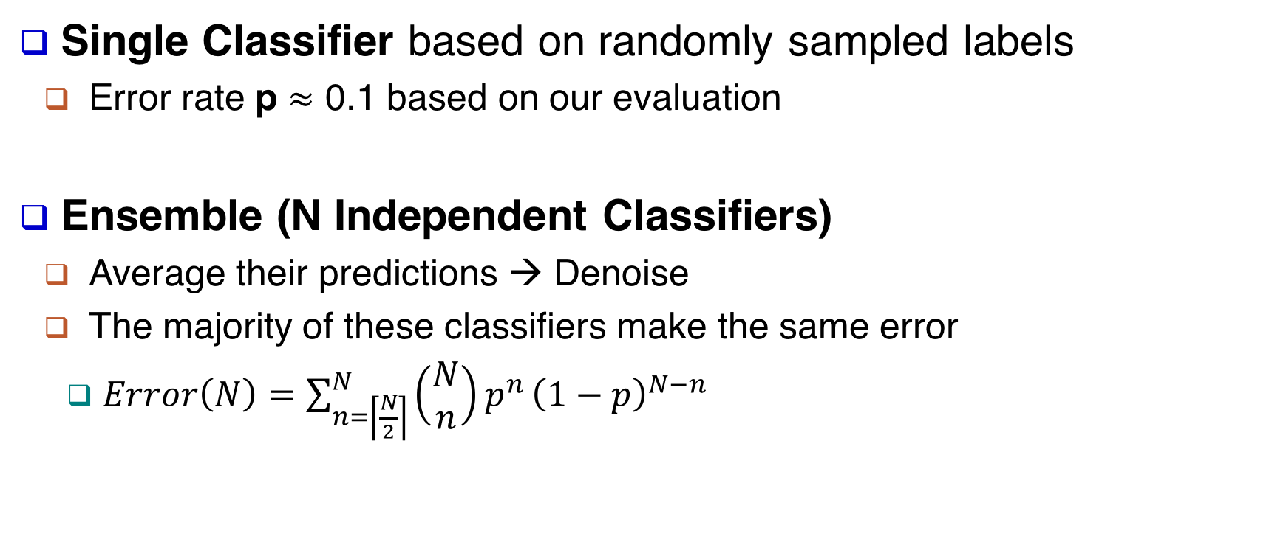
AutoPhrase (TKDE’18): Sampling + Ensemble → Robust Classifier
Single Classifier based on randomly sampled labels
Error rate p $≈$ 0.1 based on our evaluation
Ensemble (N Independent Classifiers)
Average their predictions → Denoise
The majority of these classifiers make the same error
$Error\left(N\right)=\sum_{n=\left\lceil \frac{N}{2}\right\rceil }^{N}{\left(\begin{matrix}N \\ n\end{matrix}\right)p^{n}}{\left(1−p\right)}^{N−n}$
p=
Theoretical Error → 0, when N → 10^3
Notes:
Specifically, We first build single classifier based on a random sample of positive and negative labels.
The classifier mainly has the errors caused by the noisy negative labels.
From our empirical evaluation, the error rate is about 10%.
Then we combine N independent single classifiers and take the average of their predictions.
As a binary classification problem, the ensemble classifier makes an error only when the majority of the single classifiers makes errors.
Theoretically, the error drops exponentially as shown in this figure.
In the reality, there might be more noise during the model training. So let’s evaluate whether this idea works on real-world datasets.

Slide 15
Phrase Mining: Empirical Evaluation – Precision Recall Curve
Output: a ranked list of phrases with decreasing quality
Evaluation Process
Output Results
… data mining machine learning information retrieval np hard in a strong sense … support vector machine np hard in a strong …
Evaluation Results
… 1 1 1 1 … 1 0 …
Scientific Papers
Domain Experts
Compute precision & recall at each rank
Notes:
In phrase mining, our output is a ranked list.
So we recruit domain experts to evaluate whether a phrase is a high-quality phrase or not.
For example, the phrase “np hard in a strong” will be marked as 0.
During the evaluation process, the experts are encouraged to use search engines like Google to better understand those phrases they are not very familiar with.
Based on the expert evaluation results, we can compute precision and recall at every rank.
And then we plot the precision-recall curve. In an ideal ranking result, the precision-recall curve should look like this.
In our evaluation, we mainly look at the area under the precision-recall curve.
The bigger the area is, the better the result is.

Slide 16
AutoPhrase (TKDE’18): Cross-Domain Evaluation Results
Computer Science Papers
Yelp Business Reviews
Wikipedia Articles
SegPhrase (SIGMOD’15): Outperformed TopMine (VLDB’15) and many other methods
TF-IDF: Stanford NLP Parser (LREC’16) + Ranked by TF-IDF
TextRank (ACL’04): Stanford NLP Parser (LREC’16) + Ranked by TextRank
Notes:
As we mentioned in the introduction, our methods are designed to be effective in multiple domains and languages.
We first evaluate the results in three domains: CS papers, Yelp reviews, and Wiki articles.
We mainly compared AutoPhrase with SegPhrase and Stanford NLP Parser.
SegPhrase has outperformed many unsupervised methods like TopMine. So we didn’t include the results here.
The Stanford NLP parser can extract noun phrases and verb phrases from sentences.
We use the popular TF-IDF and TextRank to rank the extracted phrases.
TF-IDF is a popular measurement in information retrieval. TF is term frequency and IDF is the inverse document frequency.
TextRank is similar to the PageRank. We construct a graph of phrases and build edges as their co-occurrence within a given sliding window. Then we run the random walk on this graph and compute the page rank.
As you can see here, AutoPhrase always has the best performance.
The compared methods include
AutoPhrase: distantly supervised
SegPhrase: weakly supervised (outperformed ToPMine, ConExtr, KEA, NLP-based + ranking, …)
NLP-based methods + TF-IDF/TextRank ranking

Slide 17
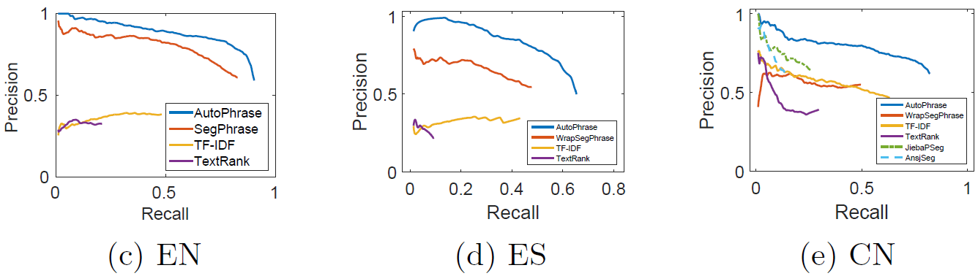
AutoPhrase (TKDE’18): Cross-Language Evaluation Results
English
Spanish
Chinese
WrapSegPhrase: non-English characters → English letters & SegPhrase
JiebaSeg: Specifically for Chinese; Dictionaries & Hidden Markov Models
AnsjSeg: Specifically for Chinese; Dictionaries & Conditional Random Fields
Notes:
We further conducted experiments in different languages.
Since SegPhrase is originally designed for English, we introduce its variant WrapSegPhrase for other languages.
We encode the non-English tokens using English letters. The first token is marked as ‘a’, the second as ‘b’, and so on.
I would like to highlight here, on the Chinese dataset, we compare with the popular, supervised Chinese phrase mining methods, Jieba Segmentation and Ansj Segmentation. They are using conditional random fields and hidden markov models trained on annotated corpora.
As you can see here, AutoPhrase performs the best.
Compared Methods:
WrapSegPhrase: encoding/decoding process for non-English languages + SegPhrase
NLP-based methods + TF-IDF/TextRank ranking
Pre-trained Chinese Segmenters: AnsjSeg and JiebaPSeg

Slide 18
AutoPhrase (TKDE’18): Results of Chinese Phrases from Wiki Articles
Phrase’s Rank | Phrase | Translation (Explanation)
1 | 江苏_舜_天 | (the name of a soccer team)
2 | 苦_艾_酒 | Absinthe
3 | 白发_魔_女 | (the name of a novel/TV-series)
4 | 笔记_型_电脑 | notebook computer, laptop
5 | 首席_执行官 | CEO
… | … | …
99,994 | 计算机_科学技术 | Computer Science and Technology
99,995 | 恒_天然 | Fonterra (a company)
99,996 | 中国_作家_协会_副_主席 | The Vice President of Writers Association of China
99,997 | 维他命_b | Vitamin B
99,998 | 舆论_导向 | controlled guidance of the media
… | … | …
The size of positive pool is about 29,000
AutoPhrase finds more than 116,000 quality phrases (quality score > 0.5)
Much more!
Notes:
After the quantitative evaluation, I would like to show you some example results.
The Chinese dataset is one of the most challenging datasets. As you may know, the tokenization is also very hard in Chinese, because there is no whitespace. Meanwhile, the volume of Chinese Wiki is much smaller than English and Spanish Wikis. This makes the distant supervision hard.
So let’s take a look at the Chinese phrase results. The first column is the rank, the second column is the phrase, and the third column is the translation.
The underscores are inserted by the tokenizer, although some of them are not accurate. AutoPhrase can find many high-quality phrases, for example, around the rank of a hundred thousand, we can still find phrases like “Computer Science and Technology”.
Most of these high-quality phrases are not covered by the Wikipedia: Only about twenty-nine thousand phrases can be found in the positive pool, while AutoPhrase has found more than a hundred and sixteen thousand phrases.

Slide 19

Phrase Mining: Impact in Various Domains
Notes:
So far, we have discussed a series of my phrase mining methods.
We have open-sourced the codes and they have been adopted in many companies and organizations, especially AutoPhrase.
For example, US Army Research Lab, ARL, is using them to analyze their battlefield reports and gain insights from the results.
In Facebook, there is a feed ranking team using our phrase mining results as important signals in their ranking system.
TripAdvisor has posted a blog about using phrase mining on their hotel reviews. As you can see here, they have obtained many meaningful phrases and these phrases further help them group hotels into different collections. Such collections can improve the user experience when looking for hotels.
As a financial organization, International money fund (IMF) is using AutoPhrase to analyze news articles and analyst reports.
We have also published a book about phrase mining and its applications.
I was not quite sure about this visibility of this book, until I did the summer internship at the hedge fund TwoSigma last year. In TwoSigma, I found my group has purchased two hard copies of this book. I guess that might be the reason that they hire me ☺.

Slide 20
Scientific Text Mining and Knowledge Graphs Chapter 1 Part 2: Named Entity Recognition and Neural Language Models
Presenter: Jingbo Shang
University of California, San Diego
jshang@ucsd.edu
Notes:
Thank you for the introduction!
Good morning, everyone!
This is Jingbo Shang from UIUC. I’m very excited to share my research with you!
My talk today is mainly about AutoNet. Automated Network Construction from Massive Text Corpora.

Slide 21
What’s Named Entity Recognition?
Wikipedia:
Named-entity recognition (NER) is a subtask of information extraction (IE) that seeks to locate and classify named entities in text into pre-defined categories.
In IE, A named entity is a real-world object.
Example
Input
Jim bought 300 shares of Acme Corp. in 2006.
Output
[Jim]_{Person} bought 300 shares of [Acme Corp.]_{Organization} in [2006]_{Time}.

Slide 22
Supervised Methods: Training Data
Sequence labeling framework
Two popular schemes
BIO: Begin, In, Out
BIOES: Begin, In, Out, End, Singleton
BIOES is arguably better than BIO (Ratinov and Roth, ACL 09)
Example:
LABELS: [Jim]_{Person} bought 300 shares of [Acme Corp.]_{Organization} in [2006]_{Time}.
TOKNES: Jim bought 300 shares of Acme Corp. in 2006 .
BIO: B-PER O O O O B-ORG I-ORG O B-Time O
BIOES: S-PER O O O O B-ORG E-ORG O S-Time O

Slide 23
Supervised Methods: Neural Models
Two pioneer models
LSTM-CRF (Lample et al., NAACL’16)
LSTM-CNN-CRF (Ma and Hovy, ACL’16)
The first neural model that outperforms the models based on handcrafted features
 | LSTM-CRF | LSTM-CNN-CRF
Word-Level | Bidirectional LSTMs | Bidirection LSTMs
Character-Level | Bidirectional LSTMs | Convolutional NN

Slide 24
“Data-Driven” Philosophy
Key
Enhance NER performance without introducing any additional human annotations
Questions
Can massive raw texts help?
Can dictionaries help?
Are human annotations always correct?
Is Tokenizer always good?
…

Slide 25
Questions
Can massive raw texts help?
Can dictionaries help?

Slide 26
Word Embedding → Language Model (LM)
Using Language Model for better representations:
Word-level Language Model:
ELMo (Peters et al., NAACL’18, best paper)
LD-Net (Liu et al., EMNLP’18)
Char-level Language Model:
LM-LSTM-CRF (Liu et al., AAAI’ 18)
Flair (Akbik et al., COLING’18)
Hybrid Language Model:
Cross View Training (Clark et al., EMNLP’ 2018)
BERT (Devlin et al., NAACL’19, best paper)

Slide 27
What’s (Neural) Language Model?
Describing the generation of text:
predicting the next word based on previous contexts
Pros:
Does not require any human annotations
Nearly unlimited training data!
Resulting models can generate sentences of an unexpectedly high quality

Slide 28
Neural LM: Example Generations
Char-by-Char Markdown Generations:
'''See also''': [[List of ethical consent processing]]
== See also ==
*[[Iender dome of the ED]]
*[[Anti-autism]]
===[[Religion|Religion]]===
*[[French Writings]]
*[[Maria]]
*[[Revelation]]
Valid Syntax!

Slide 29
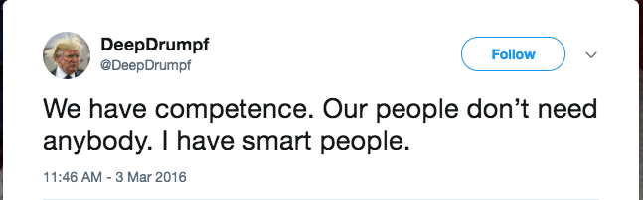
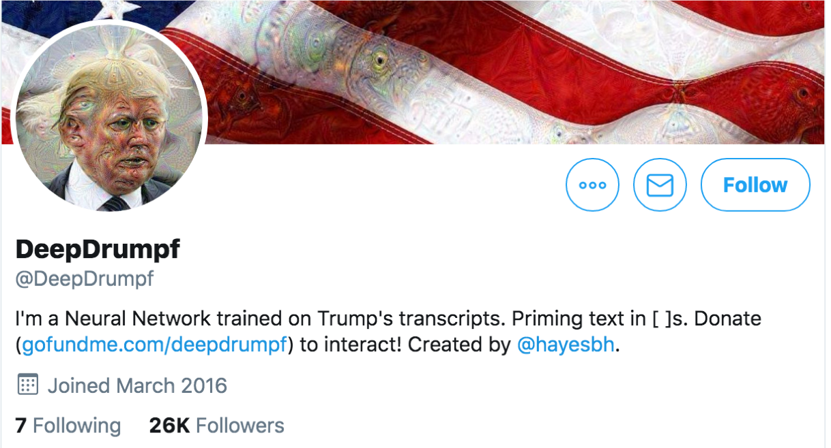
Neural LM: Example Generations
Deep “Donald Trump”: Mimic President Trump
Fooled many twitter users

Slide 30
LM-LSTM-CRF: Co-Train Neural LM
Propose to use Character-level language model as a Co-Training objective
Why character-level?
More efficient & More robust to pre-processing

Slide 31
ELMo: Pre-train Word-Level Neural LM
Add ELMo at the input of RNN. For some tasks (SNLI, SQuAD), including ELMo at the output brings further improvements
Key points:
Freeze the weight of the biLM
Regularization are necessary

Slide 32
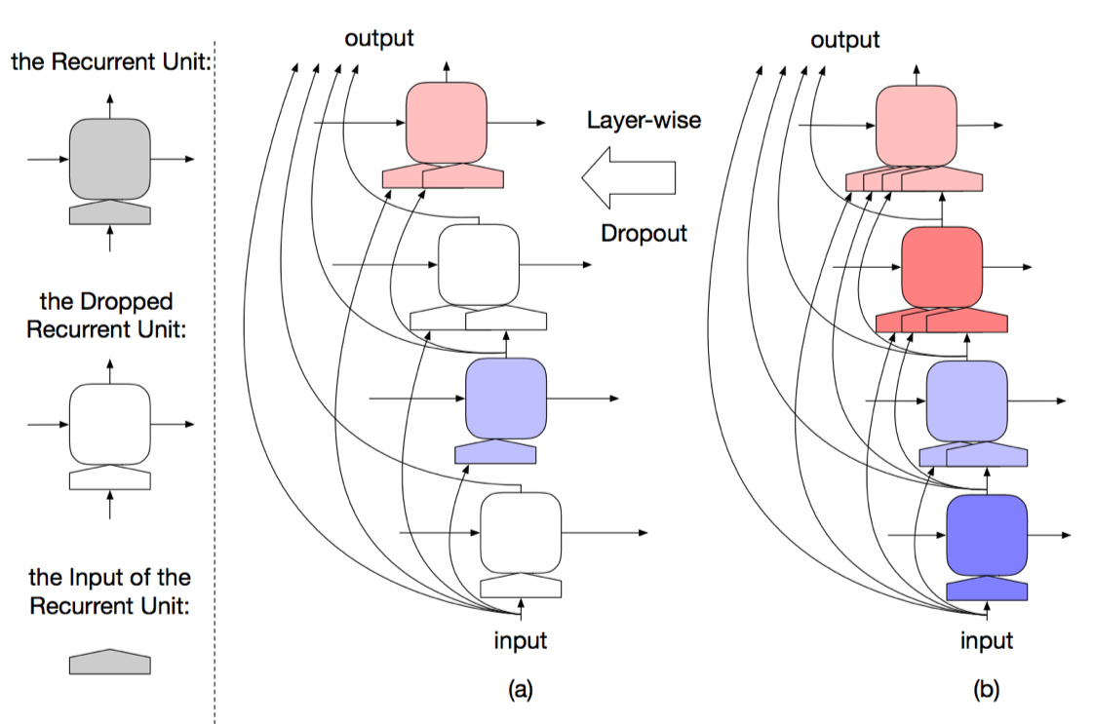
LD-Net: An efficient version of ELMo
Make the contextualized represent efficient without much loss of effectiveness
How is this even possible?
Pre-trained language model contains abundant information, however, for a specific task, only part of it could be useful.

Slide 33
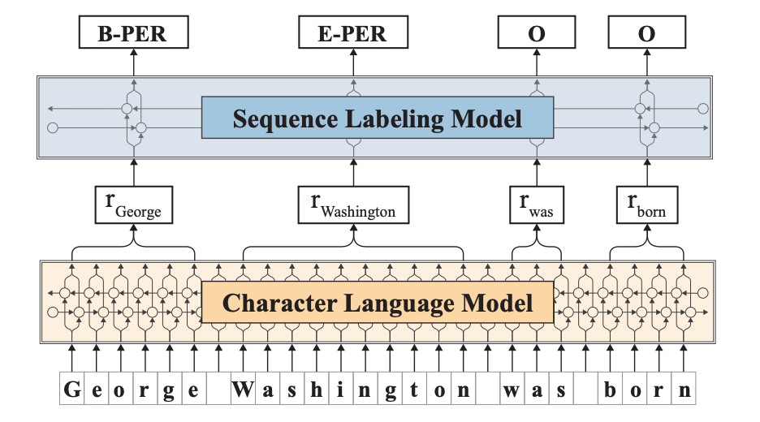
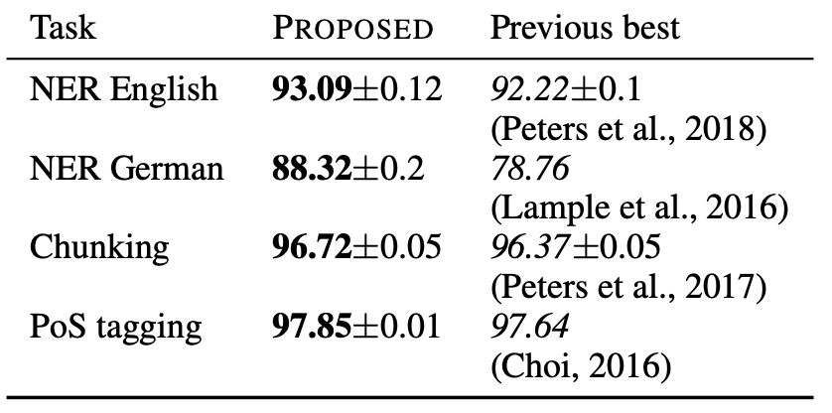
Flair: Pre-Train Neural LM at All Levels
Even for character-level language model, pre-training is very important.
The structure is the same with LM-LSTM-CRF, the difference is the pre-training conducted on additional training corpus.

Slide 34
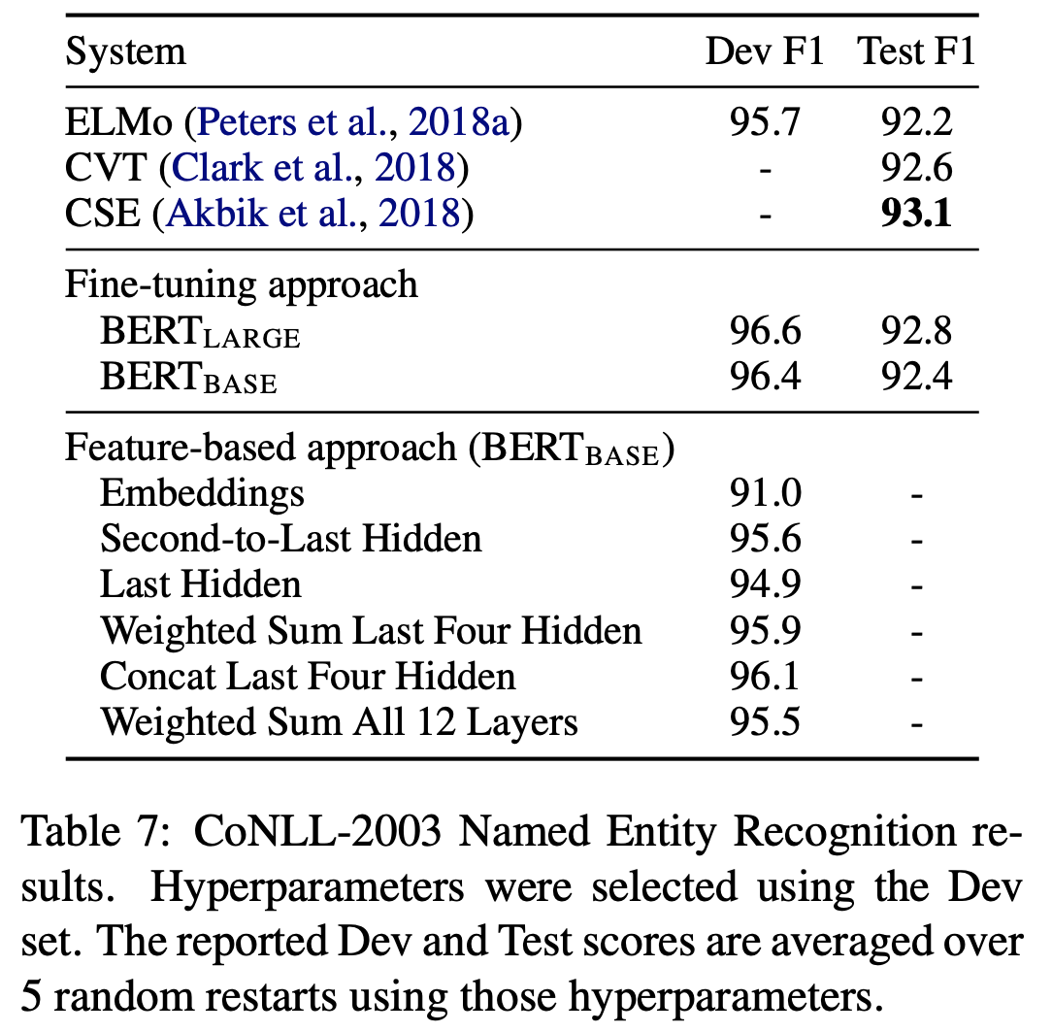
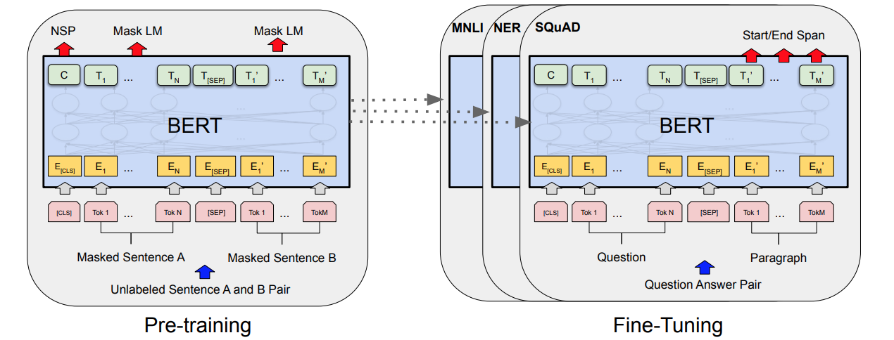
BERT: Introduce Transformer
Introduce Transformers, use masked language model + next sentence prediction
Conduct fine-tuning after pre-training on each task (necessary for sentence-level tasks, NER is a word level task).

Slide 35
New State-of-the-arts
Using Language Model for better representations:
Word-level Language Model:
ELMo (Peters et al., NAACL’18, best paper)
LD-Net (Liu et al., EMNLP’18)
Char-level Language Model:
LM-LSTM-CRF (Liu et al., AAAI’ 18)
Flair (Akbik et al., COLING’18)
Hybrid Language Model:
Cross View Training (Clark et al., EMNLP’ 2018)
BERT (Devlin et al., NAACL’19, best paper)
F1 on CoNLL03
92.2
92.0, ~5X faster
91.4
93.1
92.6
92.4 / 92.8

Slide 36
Questions
Can massive raw texts help? → Neural language model
Can dictionaries help?

Slide 37
Distantly Supervised NER
Input
Unlabeled Raw Texts
An Entity Dictionary
entity type, canonical name, [synonyms_1, synonyms_2, …, synonyms_k]
Output
A NER model to recognize the entities of the entity types appeared in the given dictionary.
Note that the entities to be recognized can be unseen entities.

Slide 38
Distantly Supervised NER Methods
String-match / rule-based distant supervision generation
AutoEntity, SwellShark, ClusType, …
Leave the entity span detection to experts
POS Tag Rule-based (e.g., regular expressions)
AutoNER
A novel “Tie-or-Break” labeling scheme + tailored neural model

Slide 39
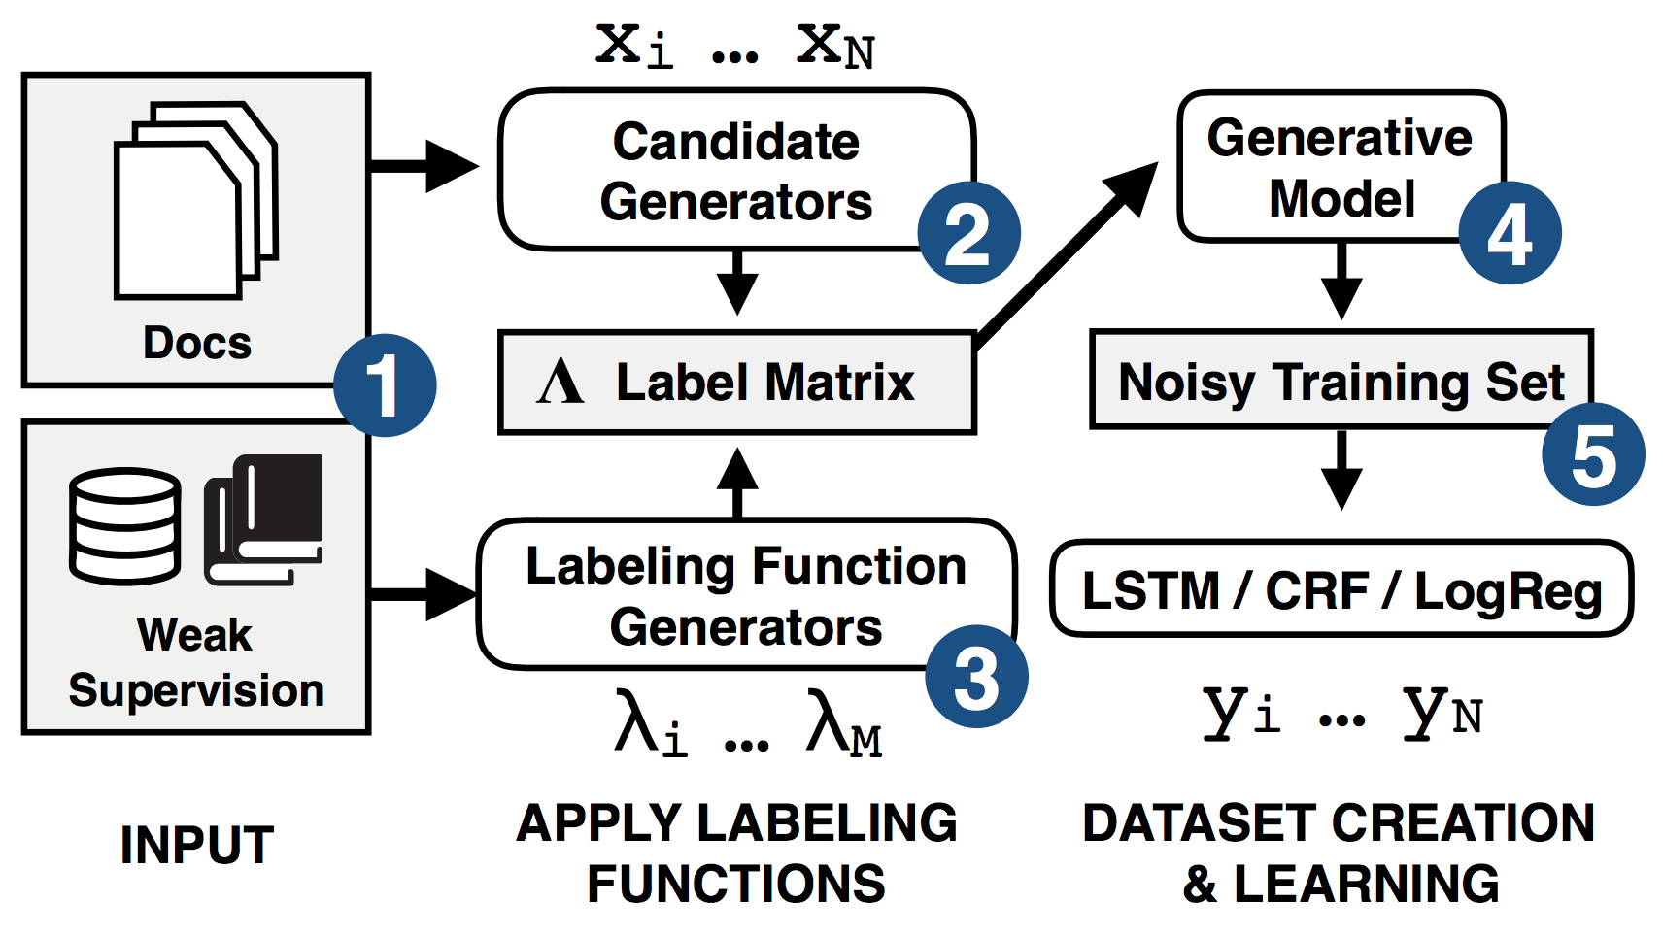
SwellShark: Distantly Supervised Typing
Data Programming for Typing
Entity Span Detection: Regular expressions based on part-of-speech (POS) tags
Requires expert efforts
Candidate Generators

Slide 40
AutoNER: Dual Dictionaries
A core dictionary
Leads to high-precision but low-recall matches
A “full” dictionary
Leads to high-recall but low-precision matches
Introduce out-of-dictionary high-quality phrases as new entities
Their types are “unknown”
It could be any IOBES + any type

Slide 41
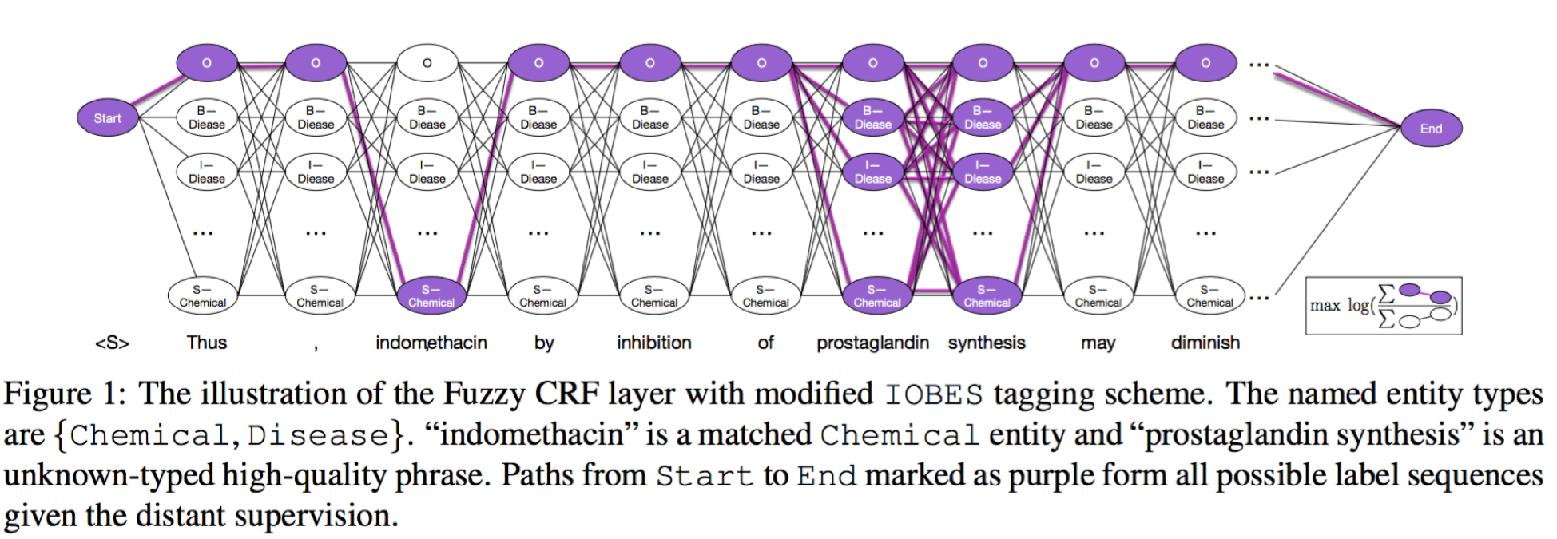
AutoNER: Fuzzy-LSTM-CRF Baseline

Slide 42
AutoNER: “Tie or Break”
Instead of labeling each token, we choose to tag the connection between two adjacent tokens.
For every two adjacent tokens, the connection between them is labeled as
(1) Tie, when the two tokens are matched to the same entity
(2) Unknown, if at least one of the tokens belongs to an unknown-typed high-quality phrase;
(3) Break, otherwise.

Slide 43
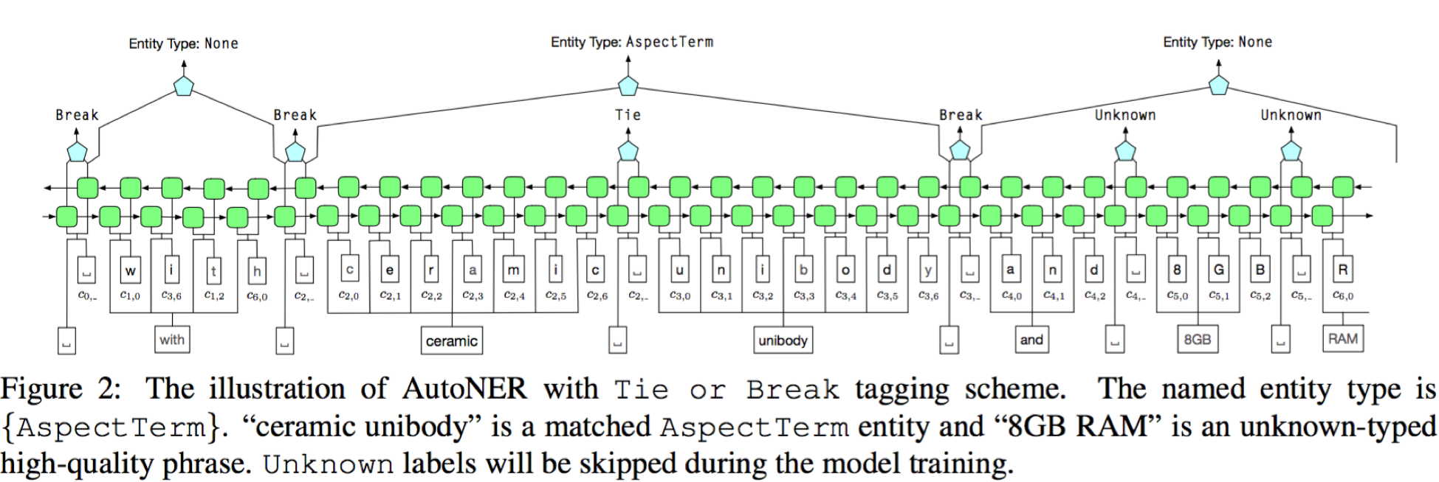
AutoNER: Tailored Neural Model

Slide 44
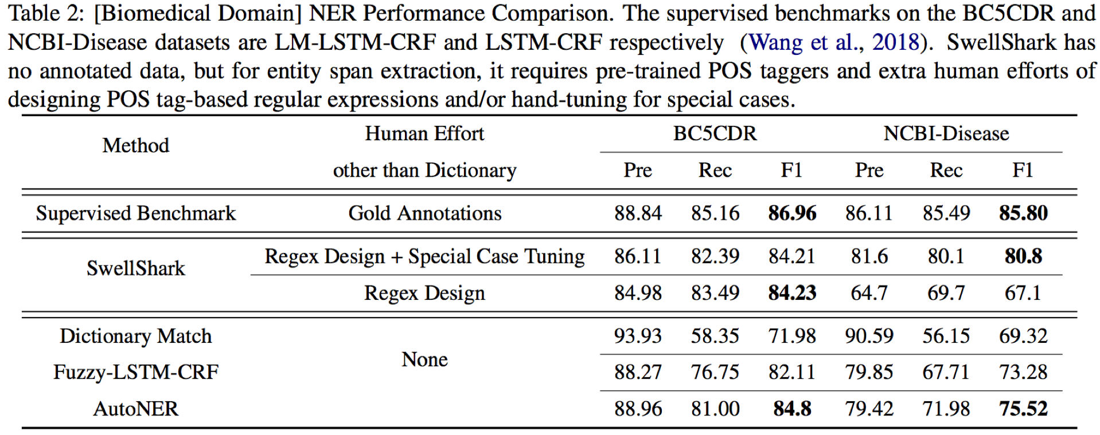
Comparison – Biomedical Domain

Slide 45
Summary & Q&A
Using neural language model, massive raw texts can help!
High-quality dictionaries can help!

Slide 46
Scientific Text Mining and Knowledge Graphs Chapter 1 Part 3: Relation Extraction and Attribute Discovery
Presenter: Jingbo Shang
University of California, San Diego
jshang@ucsd.edu
Notes:
Thank you for the introduction!
Good morning, everyone!
This is Jingbo Shang from UIUC. I’m very excited to share my research with you!
My talk today is mainly about AutoNet. Automated Network Construction from Massive Text Corpora.

Slide 47
Meta-Pattern Mining for Information Extraction
Meta-Pattern
$PERSON (age $DIGITS) $PERSON meets $PERSON
$PERSON has an attribute “age” A “meet” relation between two people
$DIGITS is the value of this attribute
Applications
Attribute Discovery: both attribute name and attribute value
Relation Extraction: relation between entities
Named Entity Recognition: entity boundaries & types
Using discovered meta-patterns to match new raw texts

Slide 48
Previous Work on Finding E-A-V and Typed Patterns
Task 1: Finding E-A-V at the Instance Level
Stanford OpenIE [ACL’15], AI²’s Open IE-Ollie [EMNLP’12]
Learn syntactic and lexical patterns of expressing relations
Input: “President Blaise Compaoré’s government of Burkina Faso was founded…”
Output: ⟨President Blaise Compaoré, have, government of Burkina Faso⟩ ☹
Task 2: Finding Typed Patterns
Google’s Biperpedia+ARI [VLDB’14, WWW’16], ReNoun [EMNLP’15]:
Input: “…Sunday night, Burkina Faso…” and the “A, E” pattern
Output: ⟨$COUNTRY, Sunday night⟩ ☹
Ignore entity-typing information!
“president of united states”
“A of E”, “E ’s A”, “E A”, “A, E”
“Barack Obama, President of U.S., ”
“O, A of S,”, “S A O”
Query log: Highly constrained and unavailable

Slide 49
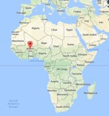
MetaPAD: Meta Pattern-driven Attribute Discovery from Massive Text Corpora
Meng Jiang, Jingbo Shang, Xiang Ren, Taylor Cassidy, Lance Kaplan, Timothy Hanratty, and Jiawei Han, “MetaPAD: Meta Pattern-driven Attribute Discovery from Massive Text Corpora”, KDD 2017
Motivation:
Given a sentence in a large corpus, “President Blaise Compaoré’s government of Burkina Faso was founded…”, …
We may find:
age:65
Blaise Compaoré: $PERSON.POLITICIAN
Burkina Faso: $COUNTRY
president
population: 17 million

Slide 50
MetaPAD: Meta Pattern-driven Attribute Discovery from Massive Text Corpora
Attribute Discovery: Two tasks
Blaise Compaoré: $PERSON.POLITICIAN
age:65
Burkina Faso: $COUNTRY
president
population: 17 million
Task 1: ⟨entity, attribute name, attribute value⟩
⟨Burkina Faso, president, Blaise Compaoré⟩
⟨Burkina Faso, population, 17 million⟩
⟨Blaise Compaoré, age, 65⟩
Task 2: ⟨entity type, attribute name⟩
⟨$COUNTRY, president⟩
⟨$COUNTRY, population⟩
⟨$PERSON, age⟩
Instance-level
Type-level

Slide 51
Our Meta-Pattern Methodology
(#1) “President Blaise Compaoré’s government of Burkina Faso was founded …”
(#2) “President Barack Obama’s government of U.S. claimed that…”
(#3) “U.S. President Barack Obama visited …”
Generate patterns with massive instances in the data
No heavy annotation required
No domain knowledge required
No query log required
if we can recognize and type the entities in the same manner…
Meta pattern segmentation
Meta patterns:
⎡president $PERSON.POLITICIAN ’s government of $LOCATION.COUNTRY⎦ was founded…
⎡$LOCATION.COUNTRY president $PERSON.POLITICIAN⎦ …
⟨$COUNTRY, {president}, $POLITICIAN⟩
Adjust types for appropriate granularity
Generate massive triples by matching the meta patterns
Group synonymous patterns by massive triples
Joint extraction
⟨Burkina Faso, {president}, Blaise Compaoré⟩
⟨U.S., {president}, Barack Obama⟩

Slide 52
Pattern Discovery by Phrase Mining and Entity Typing
“President Blaise Compaoré’s government of Burkina Faso was founded …”
Phrase mining (SegPhrase and AutoPhrase)
“president blaise_compaoré’s government of burkina_faso was founded …”
Entity recognition and typing with Distant Supervision (ClusType)
“president $PERSON’s government of $LOCATION was founded …”
Fine-grained typing (PLE by Ren et al. KDD’16)
“president $PERSON.POLITICIAN’s government of $LOCATION.COUNTRY was founded …”

Slide 53
Meta-Pattern Quality Assessment and Segmentation
A rich set of features:
Frequency
Concordance: “$PERSON’s wife”
Completeness: “$COUNTRY president” vs. “$COUNTRY president $POLITICIAN”
Informativeness: “$PERSON and $PERSON ” vs. “$PERSON ’s wife, $PERSON”
Regression Q(.): random forest with only 300 labels
Q(.)↑
president $PERSON.POLITICIAN ’s government of $LOCATION.COUNTRY

Slide 54
Grouping Synonymous Patterns
⟨$COUNTRY, president, $POLITICIAN⟩
president
$COUNTRY president $POLITICIAN
president $POLITICIAN of $COUNTRY
⟨United States, Barack Obama⟩
⟨$PERSON, {age, -year-old}, $DIGIT⟩
⟨Barack Obama, 55⟩
$PERSON, $DIGIT,
$PERSON’s age is $DIGIT
⟨Justin Trudeau, 43⟩
$PERSON, a $DIGIT-year-old

Slide 55
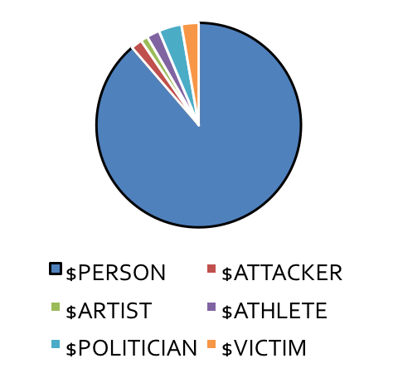
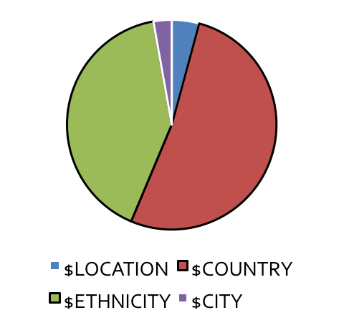
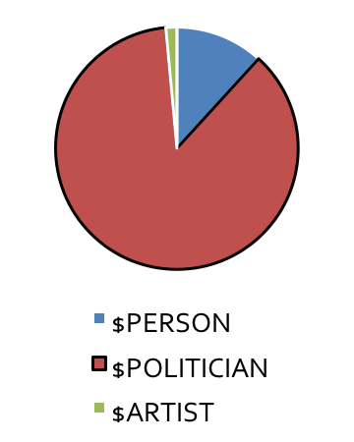
Adjusting Types in Meta Patterns for Appropriate Granularity
$PERSON, $DIGIT,
$COUNTRY president $POLITICIAN
$PERSON’s age is $DIGIT
president $POLITICIAN of $COUNTRY
$PERSON, a $DIGIT -year-old

Slide 56
Results: Patterns, Entities and Attribute Values in News Corpus
Meta patterns | Entity | Attribute value
$COUNTRY President $POLITICIAN $COUNTRY’s president $POLITICIAN President $POLITICIAN of $COUNTRY … $POLITICIAN’s government of $COUNTRY | United States | Barack Obama
 | Russia | Vladimir Putin
 | France | Francois Hollande
 | … | …
 | Burkina Faso | Blaise Compaoré
Meta patterns | Entity | Attribute value
$COMPANY CEO $PERSON $COMPANY chief executive $PERSON $PERSON, the $COMPANY CEO, … $COMPANY former CEO $PERSON $PERSON, the $COMPANY former CEO, | Apple | Tim Cook
 | Facebook | Mark Zuckerberg
 | Hewlett-Packard | Carly Fiorina
 | … | …
 | Infor | Charles Phillips
 | Afghan Citadel | Roya Mahboob

Slide 57
Patterns and Entities Found in Medical Science Corpus
Meta patterns | Entity | Attribute value
$TREATMENT was used to treat $DISEASE $DISEASE using the $TREATMENT $TREATMENT has been used to treat $DISEASE $TREATMENT of patients with $DISEASE … | zoledronic acid therapy | Paget’s disease of bone
 | bisphosphonates | osteoporosis
 | calcitonin | Paget’s disease of bone
 | calcitonin | osteoporosis
 | … | …
Meta patterns | Entity | Attribute value
$BACTERIA was resistant to $ANTIBIOTICS $BACTERIA are resistant to $ANTIBIOTICS $BACTERIA is the most resistant to $ANTIBIOTICS … $BACTERIA, particularly those resistant to $ANTIBIOTICS | corynebacterium striatum BM4687 | gentamicin
 | corynebacterium striatum BM4687 | tobramycin
 | methicillin-susceptible S aureus | vancomycin
 | multidrug-resistant enterobacteriaceae | gentamicin
 | … | …

Slide 58
Further Enhancements of MetaPAD
TruePIE
Q. Li, M. Jiang, X. Zhang, M. Qu, T. Hanratty, J. Gao, and J. Han, “TruePIE: Discovering Reliable Patterns in Pattern-Based Information Extraction”, KDD’18
Discover reliable patterns and extract quality EAV-tuples from text data
WW-PIE
Qi Li, Xuan Wang, Yu Zhang, Fei Ling, Cathy H. Wu, Jiawei Han, “Pattern Discovery for Wide-Window Open Information Extraction in Biomedical Literature”, BIBM’18
Leverage parsing structures to mine long-distance patterns

Slide 59
PENNER: Pattern-Enhanced Nested Named Entity Recognition in Biomedical Literature
Xuan Wang*, Yu Zhang*, Qi Li, Cathy H. Wu, Jiawei Han, “PENNER: Pattern-enhanced Nested Named Entity Recognition in Biomedical Literature”, BIBM’18
What is a nested entity structure?
Example: PID: 10190572:
“… although each of the agents alone caused only slight increase in the [[alanine]_{CHEMICAL} aminotransferase]_{PROTEIN} activity.”
PubTator recognizes “alanine” as a CHEMICAL but misses “alanine aminotransferase” as a PROTEIN
Nested entities are very important!
17% of the entities in the GENIA dataset are embedded with another entity
Many downstream tasks require us to detect not just the inner-most entity

Slide 60
PENNER: Key Ideas of Using Meta-Pattern
Nested BioNER with very weak supervision
Idea: Nested structure as a pattern-level phenomenon
CHEMICAL aminotransferase = PROTEIN
GENE mRNA release = PROCESS
Framework
Taking a corpus pre-tagged by any flat NER tool as input
Unsupervised meta-pattern extraction
Few-shot nested entity recognition for each type
Evaluation
Outperforming baselines in both meta-pattern extraction and nested NER
Detecting new entity types with few seeds
Improving annotation results over PubTator

Slide 61
Framework Overview
Input Corpus
Flat Entity Recognition
Meta-Pattern Extraction
ID | Sentence
1 | TERT encodes the reverse transcriptase subunit of human telomerase.
2 | The FGFR-2 receptor is a membrane-spanning tyrosine kinase.
3 | Each of the agents alone caused only slight increase in the alanine aminotransferase activity.
… | …
ID | Sentence
1 | GENE_TERT encodes the reverse transcriptase subunit of SPECIES_human telomerase.
2 | The GENE_FGFR-2 receptor is a membrane-spanning CHEMICAL_tyrosine kinase.
3 | Each of the agents alone caused only slight increase in the CHEMICAL_alanine aminotransferase activity.
… | …
Meta-Pattern
SPECIES telomerase
CHEMICAL kinase
CHEMICAL aminotransferase
GENE level
male SPECIES
several DISEASE
…
Weak Supervision
Context Information
Pattern Expansion
Seed Sets
Round 1
Round 2
…
Nested Entity Recognition
GENE
CHEMICAL peroxidase
SPECIES telomerase
CHEMICAL kinase
CHEMICAL aminotransferase
CHEMICAL hydrolase
ID | Sentence
1 | TERT encodes the reverse transcriptase subunit of GENE_human_telomerase.
2 | The FGFR-2 receptor is a membrane-spanning GENE_tyrosine_kinase.
3 | Each of the agents alone caused only slight increase in the GENE_alanine_aminotransferase activity.
… | …
GENE
CHEMICAL peroxidase
SPECIES telomerase
CHEMICAL kinase
GENE
CHEMICAL peroxidase
…
CHEMICAL
GENE agonist
CHEMICAL
GENE agonist
GENE antagonist
…
…
GENE upregulation
GENE downregulation
GENE upregulation
GENE downregulation
GENE expression
…
…

Slide 62
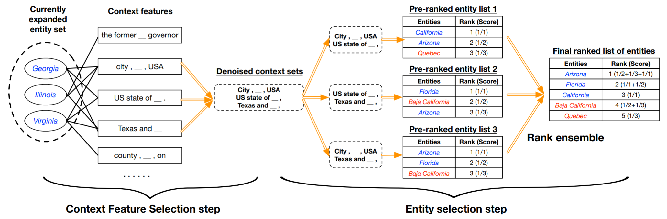
Weakly-supervised Pattern Expansion
Finding new patterns with few user-specified seeds
Method: SetExpan (Shen et al., ECML-PKDD 2017): Skip-gram + Rank Ensemble
Weak supervision
(User-specified seeds)
Context Information
(Corpus)
Round 2
…
Round 1
GENE
CHEMICAL peroxidase
SPECIES telomerase
CHEMICAL kinase
CHEMICAL aminotransferase
CHEMICAL hydrolase
Seed Sets
GENE
CHEMICAL peroxidase
SPECIES telomerase
CHEMICAL kinase
GENE
CHEMICAL peroxidase
…

Slide 63
Expanding Multiple Sets Simultaneously
SetExpan essentially combines frequency and context similarity
Unlike entities, some meta-patterns may be extremely frequent (e.g., “CHEMICAL”)
Utilizing the mutual exclusiveness of seed sets
Seed Sets
Round 1
Round 2
…
GENE
CHEMICAL peroxidase
SPECIES telomerase
CHEMICAL kinase
CHEMICAL aminotransferase
CHEMICAL hydrolase
GENE
CHEMICAL peroxidase
SPECIES telomerase
CHEMICAL kinase
GENE
CHEMICAL peroxidase
…
CHEMICAL
GENE agonist
CHEMICAL
GENE agonist
GENE antagonist
…
…
GENE upregulation
GENE downregulation
GENE upregulation
GENE downregulation
GENE expression
…
…

Slide 64
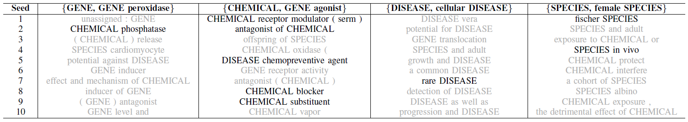
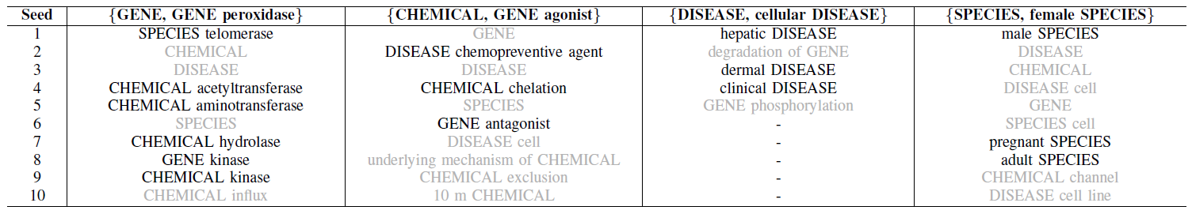
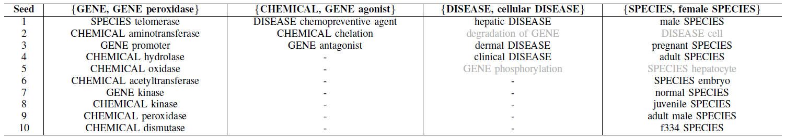
Pattern-Level Task: Meta-Pattern Extraction
Embedding
SetExpan
PENNER

Slide 65
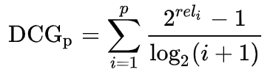
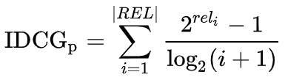
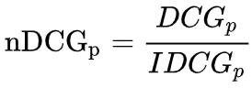
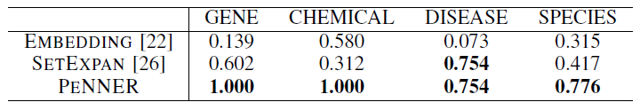
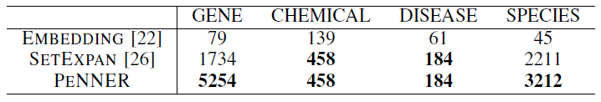
Entity-level Task: Nested NER
“Precision”: NDCG of the ranking list of expanded entities
“Recall”: Number of correct instances
Embedding does not consider frequency—Infrequent patterns may have inaccurate embeddings
SetExpan does not exploit mutual exclusiveness—Extremely frequent patterns may cause semantic drift during expansion

Slide 66
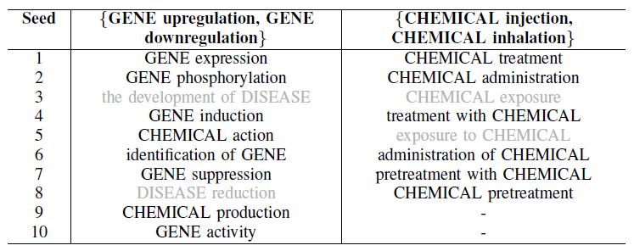
Entity-level Task: Nested NER
Detecting Biological Process and Treatment entities using only two seeds!
Fine-grained flat NER may further improve the performance.
E.g., pattern1: CHEMICAL treatment (Treatment)
instance: CHEMICAL = resveratrol, simvastatin, quercetin, … (drug)
pattern2: CHEMICAL exposure (symptom rather than treatment)
instance: CHEMICAL = lead, mercury, hydrofluoric acid, … (toxic)

Slide 67
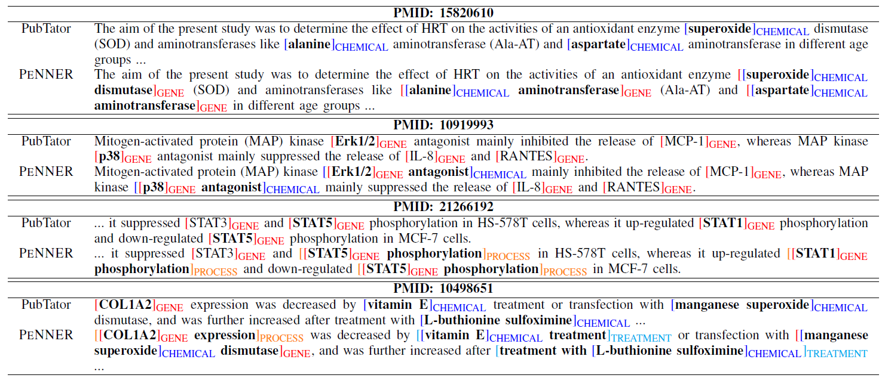
Comparison with PubTator
Nested Structure + New Entity Types

